Slide 1

Programming Languages
Third Edition
Chapter 1
Introduction

Slide 2
Objectives
Describe the origins of programming languages
Understand abstractions in programming languages
Understand computational paradigms
Understand language definition
Understand language translation
Describe the future of programming languages
Programming Languages, Third Edition

Slide 3
Introduction
How we program computers influences how we think about computation, and vice versa
Basic principles and concepts of programming languages are part of the fundamental body of knowledge of computer science
  The study of these principles is essential to programmers and computer scientists
This chapter introduces basic notions of programming languages and outlines some basic concepts
Programming Languages, Third Edition

Slide 4
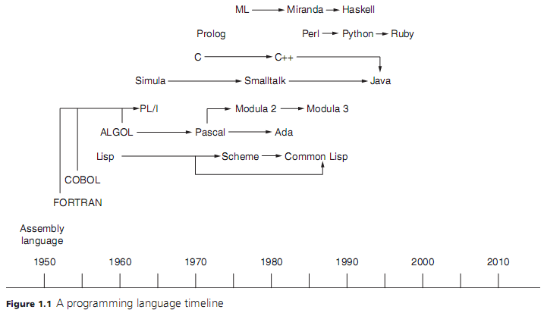
Programming Languages, Third Edition

Slide 5
Origins of Programming Languages
Programming language: often defined as “a notation for communicating to a computer what we want it to do”
Before the mid 1940s, computer operators set switches to adjust the internal wiring of a computer to perform the requested tasks
Programming languages allowed computer users to solve problems without having to reconfigure hardware
Programming Languages, Third Edition

Slide 6
Assumptions About Programming
How much does code weigh?
Programming Languages, Third Edition

Slide 7
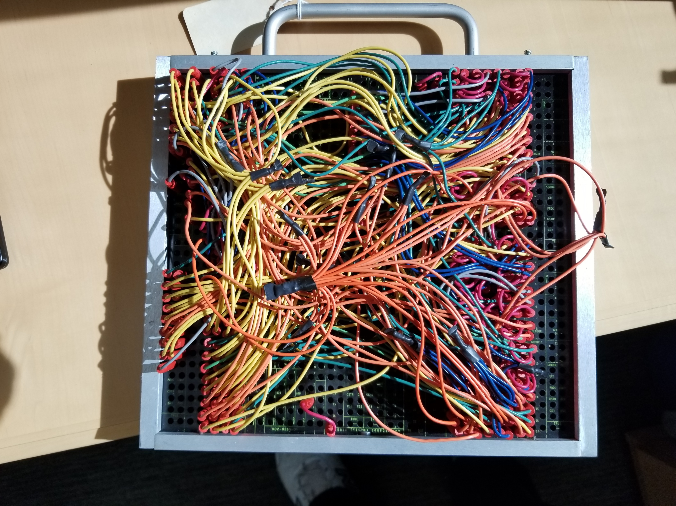
Programs as Objects
Programming Languages, Third Edition

Slide 8

Wednesday Sept 1st
Programming Languages, Third Edition

Slide 9
The Halting Problem
Is there something Computers can not do?
How do we know?
https://youtu.be/macM_MtS_w4
And for those who think the math isn’t easy
This version a la Dr. Suess makes it breezy
http://www.lel.ed.ac.uk/~gpullum/loopsnoop.html
Programming Languages, Third Edition

Slide 10
Machine Language and the First Stored Programs
John von Neumann: proposed that computers should be permanently hardwired with a small set of general-purpose operations
  Would allow the operator to input a series of binary codes to organize the basic hardware operations to solve more specific problems
  Operators could flip switches to enter these codes, called machine language, into memory
Programming Languages, Third Edition

Slide 11
Programming Language Truths
Thousands exist
More created every year
Popular now does not mean popular forever
https://youtu.be/Og847HVwRSI
Programming Languages, Third Edition

Slide 12
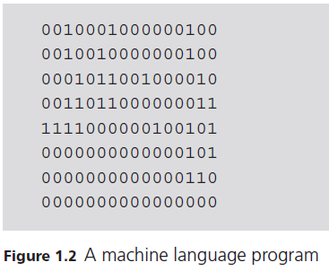
Machine Language and the First Stored Programs (cont’d.)
Programming Languages, Third Edition

Slide 13
Machine Language and the First Stored Programs (cont’d.)
Each line of code has 16 bits or binary digits
  Represents either a single machine language instruction or a single data value
Program execution begins with the first line of code
  Code is fetched from memory, decoded (interpreted), and executed
Control then moves to the next line of code and continues until a halt instruction is reached
Opcode: the first 4 bits of a line of code
  Indicates the type of operation to be performed
Programming Languages, Third Edition

Slide 14
Machine Language and the First Stored Programs (cont’d.)
Next 12 bits contain code for the instruction’s operands
Operand codes are either the numbers of machine registers or relate to addresses of other data or instructions in memory
Machine language programming was tedious and error prone
Programming Languages, Third Edition

Slide 15
Assembly Language, Symbolic Codes, and Software Tools
Assembly language: a set of mnemonic symbols for instruction codes and memory locations
  Example: LD R1, FIRST
Assembler: a program that translates the symbolic assembly language code to binary machine code
Loader: a program that loads the machine code into computer memory
Input devices:
  Keypunch machine
  Card reader
Programming Languages, Third Edition

Slide 16
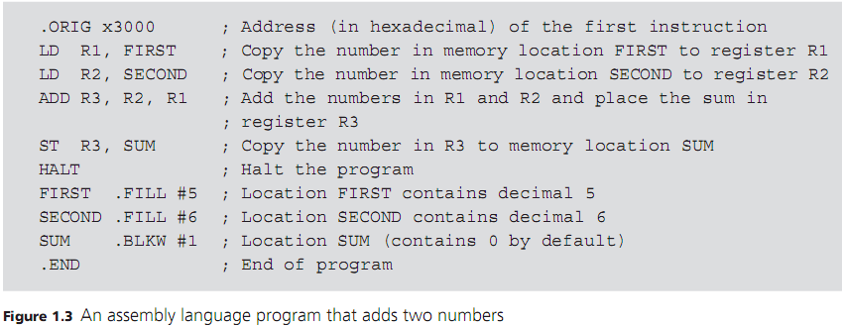
Assembly Language, Symbolic Codes, and Software Tools (cont’d.)
Programming Languages, Third Edition

Slide 17
Assembly Language, Symbolic Codes, and Software Tools (cont’d.)
Mnemonic symbols were an improvement over binary machine codes but still had shortcomings
  Lacks abstraction of conventional mathematical notation
  Each type of computer hardware architecture has its own machine language instruction set and requires its own dialect of assembly language
Assembly languages first appeared in the 1950s and are still used today for low-level system tools or for hand-optimization
Programming Languages, Third Edition

Slide 18
FORTRAN and Algebraic Notation
FORTRAN: FORmula TRANslation language
  Developed by John Backus in the early 1950s
  Reflected the architecture of a particular type of machine
  Lacked the structured control statements and data structures of later high-level languages
Popular with scientists and engineers for its support for algebraic notation and floating-point numbers
Programming Languages, Third Edition

Slide 19
The ALGOL Family: Structured Abstractions and Machine Independence
ALGOL: ALGOrithmic Language released in 1960
  Provided a standard notation for computer scientists to publish algorithms in journals
  Included structured control statements for sequencing (begin-end blocks), loops (for loop), and selection (if and if-else statements)
  Supported different numeric types
  Introduced the array structure
  Supported procedures, including recursive procedures
Programming Languages, Third Edition

Slide 20
The ALGOL Family (cont’d.)
ALGOL achieved machine independence with the requirement for an ALGOL compiler with each type of hardware
Compiler: translates programming language statements into machine code
ALGOL was the first language to receive a formal specification or definition
  Included a grammar that defined its features for both programmers and for compiler writers
Programming Languages, Third Edition

Slide 21
The ALGOL Family (cont’d.)
Large number of high-level languages descended from ALGOL, including:
  Pascal: language for teaching programming in the 1970s
  Ada: for embedded applications of U.S. Dept. of Defense
Programming Languages, Third Edition

Slide 22
Computation without the von Neumann Architecture
High-level languages still echoed the underlying architecture of the von Neumann model of a machine
  Memory area for programs and data are stored
  Separate central processing unit that sequentially executes instructions fetched from memory
Improvements in processor speed and increasing abstraction in programming languages led to the information age
Programming Languages, Third Edition

Slide 23
Computation without the von Neumann Architecture (cont’d.)
Progress in language abstraction and hardware performance ran into separate roadblocks:
  Hardware began to reach the limits of improvements predicted by Moore’s Law, leading to the multi-core approach
  Large programs were difficult to debug and correct
  Single-processor model of computation cannot be easily mapped into new architecture of multiple CPUs executing in parallel
Programming Languages, Third Edition

Slide 24
Computation without the von Neumann Architecture (cont’d.)
Solution: languages need not be based on a particular model of hardware but need only to support models of computation suitable for styles of problem solving
Lambda calculus: computational model developed by mathematician Alonzo Church
  Based on the theory of recursive functions
Lisp: programming language that uses the functional model of computation
Programming Languages, Third Edition

Slide 25
Computation without the von Neumann Architecture (cont’d.)
Other languages modeled on non-von Neumann models of computing that lend themselves to parallel processing include:
  A formal logic model with automatic theorem proving
  A model involving the interaction of objects via message passing
Programming Languages, Third Edition

Slide 26
Abstractions in Programming Languages
Two types of programming language abstractions:
  Data abstraction
  Control abstraction
Data abstractions: simplify the behavior and attributes of data for humans
  Examples: numbers, character strings, search trees
Control abstractions: simplify properties of the transfer of control
  Examples: loops, conditional statements, procedure calls
Programming Languages, Third Edition

Slide 27
Abstractions in Programming Languages (cont’d.)
Abstractions can also be categorized by levels (measures of the amount of information contained or hidden in the abstraction)
Basic abstractions: collect the most localized machine information
Structured abstractions: collect intermediate information about the structure of a program
Unit abstractions: collect large-scale information in a program
Programming Languages, Third Edition

Slide 28
Data: Basic Abstractions
Basic data abstraction:
  Hides internal representation of common data values
    Values are also called “primitive” or “atomic” because the programmer cannot normally access the component parts or bits of the internal representation
  Variables: use of symbolic names to hide computer memory locations containing data values
  Data types: names given to kinds of data values
  Declaration: the process of giving a variable a name and a data type
Programming Languages, Third Edition

Slide 29
Data: Basic Abstractions (cont’d.)
Basic data abstractions (cont’d.):
  Standard mathematical operations, such as addition and multiplication
Programming Languages, Third Edition

Slide 30
Data: Structured Abstractions
Data structure: collects related data values into a single unit
  Hides component parts but can be constructed from parts, and parts can be accessed and modified
Examples:
  Employee record contains name, address, phone, salary (different data types)
  Array: sequence of individually indexed items with the same data type
  Text file: a sequence of characters for transfer to and from an external storage device
Programming Languages, Third Edition

Slide 31
Data: Unit Abstractions
Information hiding: defining new data types (data and operations) that hide information
Unit abstraction: often associated with the concept of an abstract data type
  A set of data values and the operations on those values
Separates the interface from the implementation
  Interface: set of operations available to the user
  Implementation: internal representation of data values and operations
Programming Languages, Third Edition

Slide 32
Data: Unit Abstractions (cont’d.)
Examples:
  Module in ML, Haskell, and Python
  Package in Lisp, Ada, and Java
  Class mechanism in object-oriented languages
Unit abstraction also provides reusability
Typically, components are entered into a library and become the basis for library mechanisms
  Interoperability allows combination of units
Application programming interface (API): gives information about the resource’s components
Programming Languages, Third Edition

Slide 33
Control: Basic Abstractions
Basic control abstractions: statements that combine a few machine instructions into an abstract statement that is easier to understand
Syntactic sugar: a mechanism that allows you to replace a complex notation with a simpler, shorthand notation
  Example: x += 10 instead of x = x + 10
Programming Languages, Third Edition

Slide 34
Control: Structured Abstractions
Structured control abstractions: divide a program into groups of instructions nested within tests that govern their execution
  Help to express the logic of primary control structures of sequencing, selection, and iteration
Branch instructions: instructions that support selection and iteration to memory locations other than the next one
Programming Languages, Third Edition

Slide 35
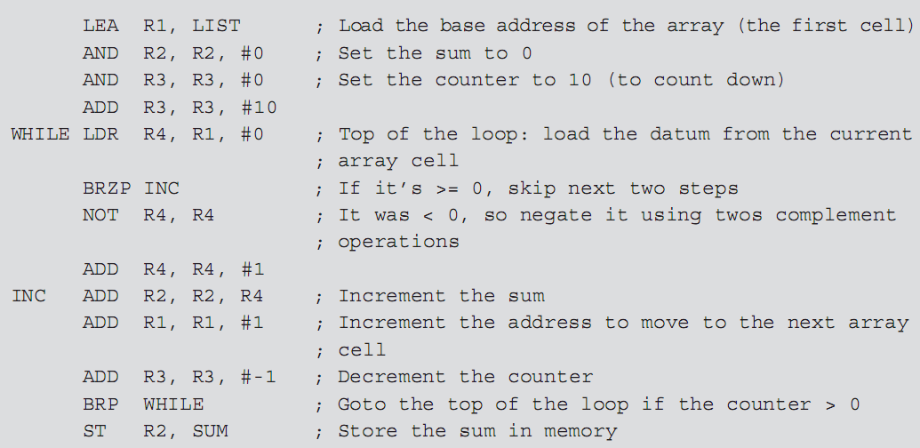
Control: Structured Abstractions (cont’d.)
Programming Languages, Third Edition

Slide 36
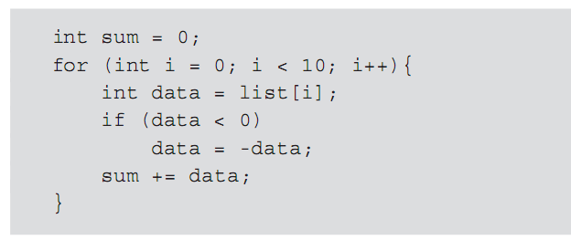
Control: Structured Abstractions (cont’d.)
Programming Languages, Third Edition

Slide 37
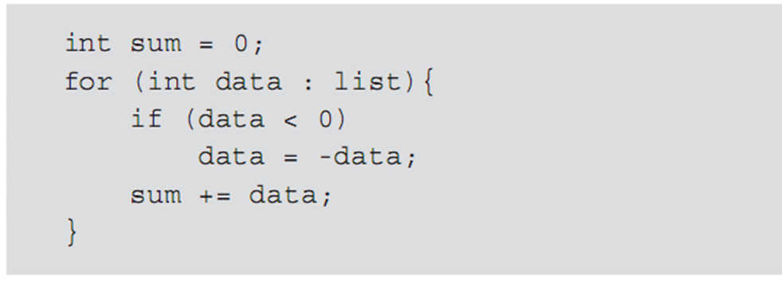
Control: Structured Abstractions (cont’d.)
Iterator: an object associated with a collection (such as array, list, set, or tree)
  Open an iterator on a collection, then visit all the elements by using the iterator’s methods
Syntactic sugar for iterator in Java: enhanced for loop
Programming Languages, Third Edition

Slide 38
Control: Structured Abstractions (cont’d.)
Procedure (or subprogram or subroutine): groups a sequence of actions into a single action that can be called or invoked from other points in the program
  Procedure declaration: names a procedure and associates it with the actions to be performed
  Invocation (or procedure activation): the act of calling the procedure
  Parameters: values that can change from call to call
  Arguments (or actual parameters): values supplied by the caller for the parameters
Programming Languages, Third Edition

Slide 39
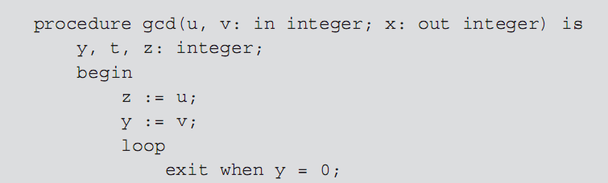
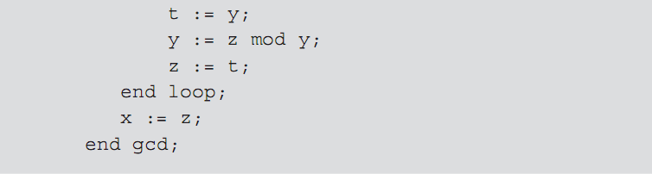
Control: Structured Abstractions (cont’d.)
Programming Languages, Third Edition

Slide 40
Control: Structured Abstractions (cont’d.)
Runtime environment: the system implementation of the program
  Stores information about the condition of the program and the way procedures operate
Function: closely related to a procedure
  Returns a value or result to its caller
  Can be written to correspond more closely to mathematical abstractions
Recursion: a mechanism that further exploits the abstraction mechanism
Programming Languages, Third Edition

Slide 41
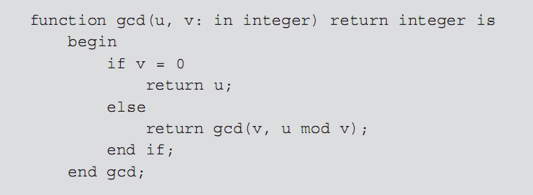

Control: Structured Abstractions (cont’d.)
Programming Languages, Third Edition

Slide 42

Control: Structured Abstractions (cont’d.)
Higher-order functions: functions that can accept other functions as arguments and return functions as values
Example: map function
  Expects another function and a collection as arguments
  Applies the argument function to each element in the argument collection and returns a list of results
Programming Languages, Third Edition

Slide 43
Control: Unit Abstractions
Unit: a stand-alone collection of procedures providing logically related services to other parts of a program
  Allows a program to be understood as a whole without needing to know the details of the services provided by the unit
Threads: separately executed control paths within the Java system
Processes: other programs executing outside the Java system
Task: mechanism in Ada for parallel execution
Programming Languages, Third Edition

Slide 44
Computational Paradigms
Imperative language: a language with three properties
  Sequential execution of instructions
  Use of variables representing memory locations
  Use of assignment to change the values of variables
Represents one paradigm (pattern) for programming languages
von Neumann bottleneck: requirement that a program be described as a sequence of instructions
Programming Languages, Third Edition

Slide 45
Computational Paradigms (cont’d.)
Functional paradigm:
  Based on the abstract notion of a function in lambda calculus
Logic paradigm:
  Based on symbolic logic
Both functional and logic paradigms correspond to mathematical foundations
  Makes it easier to determine if a program will execute correctly
Programming Languages, Third Edition

Slide 46
Computational Paradigms (cont’d.)
Object-oriented paradigm:
  Reusable code that operates in a way to mimic behaviors of real-world objects
Programming Languages, Third Edition

Slide 47
Language Definition
Formal language definition provides benefits:
  Helps to allow you to reason mathematically about programs
  Promotes standardization for machine or implementation independence
  Defines program behavior and interaction
  Ensures discipline when a language is designed
Language definition can be loosely divided into:
  Syntax, or structure
  Semantics, or meaning
Programming Languages, Third Edition

Slide 48
Language Syntax
Language syntax: similar to the grammar of a natural language
Grammar: formal definition of the language’s syntax
Lexical structure: structure of the language’s words
  Similar to spelling in natural languages
Tokens: the language’s words
  Includes keywords, identifiers, symbols for operations, special punctuation symbols, etc.
Programming Languages, Third Edition

Slide 49
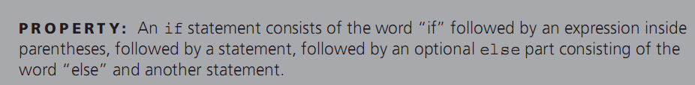
Language Syntax (cont’d.)
Example: if statement in C
Programming Languages, Third Edition

Slide 50
How different can they be?
How many ways can you define a function?
http://rosettacode.org/wiki/Function_definition
How many ways can you depict a loop?
http://rigaux.org/language-study/syntax-across-languages/CntrFlow.html#CntrFlowLoop
Programming Languages, Third Edition

Slide 51
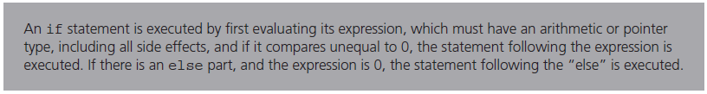
Language Semantics
Semantics: meaning of a language
  Describes the effects of executing the code
  Difficult to provide a comprehensive description of meaning in all contexts
Example: if statement in C
Programming Languages, Third Edition

Slide 52
Language Semantics (cont’d.)
No generally accepted formal method for describing semantics
Several notational systems have been developed:
  Operational semantics
  Denotational semantics
  Axiomatic semantics
Programming Languages, Third Edition

Slide 53
Language Translation
Translator: a program that accepts other programs and either directly executes them or transforms them into a form suitable for execution
Two major types of translators:
  Interpreter: executes a program directly
  Compiler: produces an equivalent program in a form suitable for execution
Programming Languages, Third Edition

Slide 54
Interpretation vs Translation
When diplomats meet, they need to converse in real-time and use someone who can speak both languages and the translation happens in real-time
Example: The United Nations
When a publisher wants to make a book available in a new language, it might take weeks / months / years to produce
Example: The Rosetta Stone and Ancient Egyptian
Programming Languages, Third Edition

Slide 55
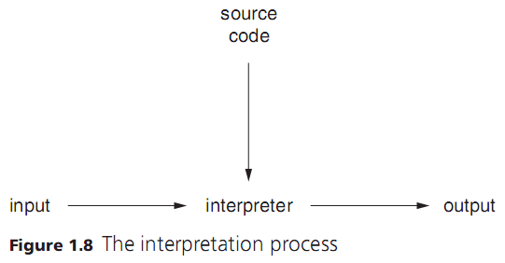
Language Translation (cont’d.)
Interpretation is a one-step process
  Both the program and the input are provided to the interpreter, and the output is obtained
Programming Languages, Third Edition

Slide 56
Language Translation (cont’d.)
Compilation requires at least two steps
  Source program is input to the compiler
  Target program is output from the compiler
Target language is often assembly language, so the target program must be:
  Translated by an assembler into an object program
  Linked with other object programs
  Loaded into appropriate memory locations
Programming Languages, Third Edition

Slide 57
Language Translation (cont’d.)
Target language may be byte code (a form of low-level code)
  Byte code is then executed by an interpreter called a virtual machine
Virtual machine: written differently for different hardware architectures
  Byte code is machine-independent
  Examples: Java, Python
Programming Languages, Third Edition

Slide 58
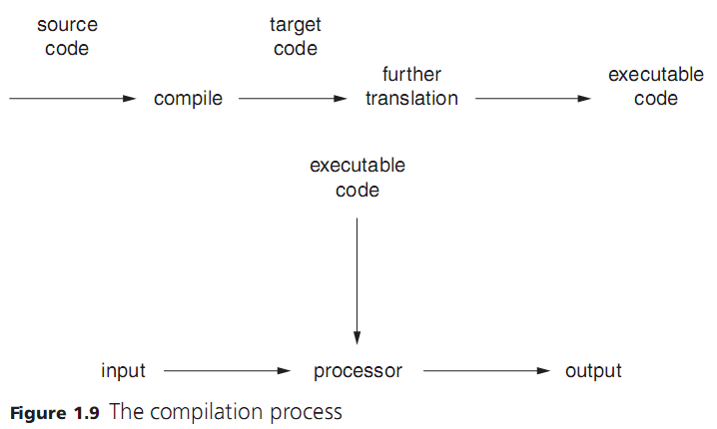
Language Translation (cont’d.)
Programming Languages, Third Edition

Slide 59
Language Translation (cont’d.)
Possible for a language to be defined by the behavior of a particular interpreter or compiler
  Called a definitional translator
  Not common
Programming Languages, Third Edition

Slide 60
Future of Programming Languages
In the 1960s, computer scientists wanted a single universal programming language to meet all needs
In the late 1970s and early 1980s, they wanted specification languages that would allow users to define the needs and then generate the system
  This is what logic programming languages attempt to do
Programming has not become obsolete
  New languages will arise to support new technologies that arise
Programming Languages, Third Edition

Slide 61
Future of Programming Languages
Practical vs Theory
  C is simple, less elegant, unsafe
  LISP is elegant, powerful, very high-level
  Gabriel and Graham discussion on pg. 20
Fourth Generation Languages
Programming Languages, Third Edition

Slide 62
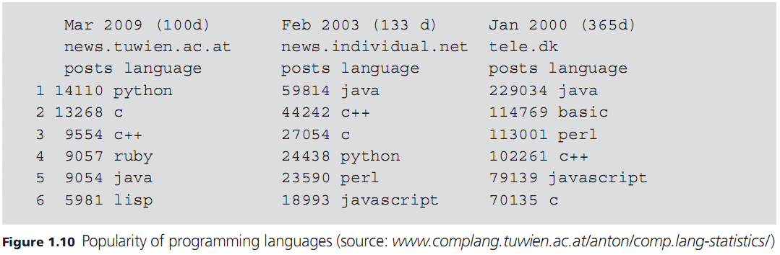
Future of Programming Languages (cont’d.)
Relative popularity of programming languages since 2000, based on number of posts on newsgroups:
Programming Languages, Third Edition

Slide 63
Resources
Code idiom sites
  http://rosettacode.org/wiki/Function_definition#6502_Assembly
  http://rigaux.org/language-study/syntax-across-languages/CntrFlow.html#CntrFlowLoop
Programming Languages, Third Edition

